Slide 1
CMPE 220
Class 10 – Operating Systems - part 1
Notes:
Let’s talk about history.
California State Railroad Museum – 1976 - docents worked on original steam engines.

Slide 2
What is an Operating System?
Wikipedia: An operating system (OS) is system software that manages computer hardware, software resources, and provides common services for computer programs.
TechTerms: An operating system, or "OS," is software that communicates with the hardware and allows other programs to run. It is comprised of system software, or the fundamental files your computer needs to boot up and function.
HowToGeek: An operating system is the primary software that manages all the hardware and other software on a computer. The operating system, also known as an “OS,” interfaces with the computer’s hardware and provides services that applications can use.

Slide 3
What is an Operating System?
Applications
Business programs, scientific programs, utility programs
System Software
Compilers, assemblers, linkers, loaders, debuggers, databases
Operating System
Computer Hardware
Instruction Set
I/O Architecture
Memory

Slide 4
History
The first computers (1940s) did not have an operating system.
Computers had a primitive absolute loader – often stored in some form of non-volatile memory
Programs were loaded – typically from punched cards – and had complete control over the hardware
Programmers were responsible for memory management and I/O
When the program was done (or crashed), the next user would take over the computer and load their program
Microcomputers in the 1970s followed the same path, except programs were usually loaded from punched paper tape

Slide 5
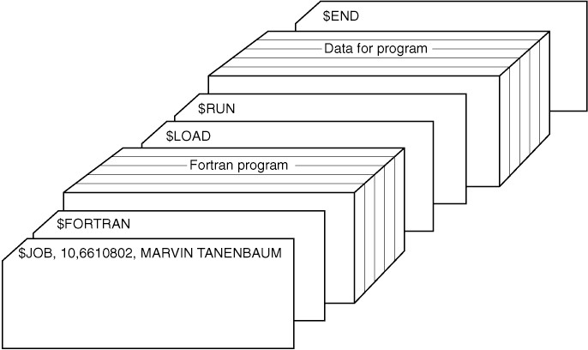
History: Job Control Languages (JCL)
The first step forward (1950s) was the ability to automatically load and run a series of programs, using a primitive “job control language” (JCL)

Slide 6
History: Job Control Programs
This required a small “job control program” to remain resident in memory.
This was a tradeoff. It used (precious) memory, but it made more efficient use of the computer
Batch processing
Moved on quickly when programs didn’t work
Did not require the programmer to be present
This began a slippery slope
Saving work from programmers by adding functions to the resident job control program. Programming became simpler, but the control program got bigger.

Slide 7
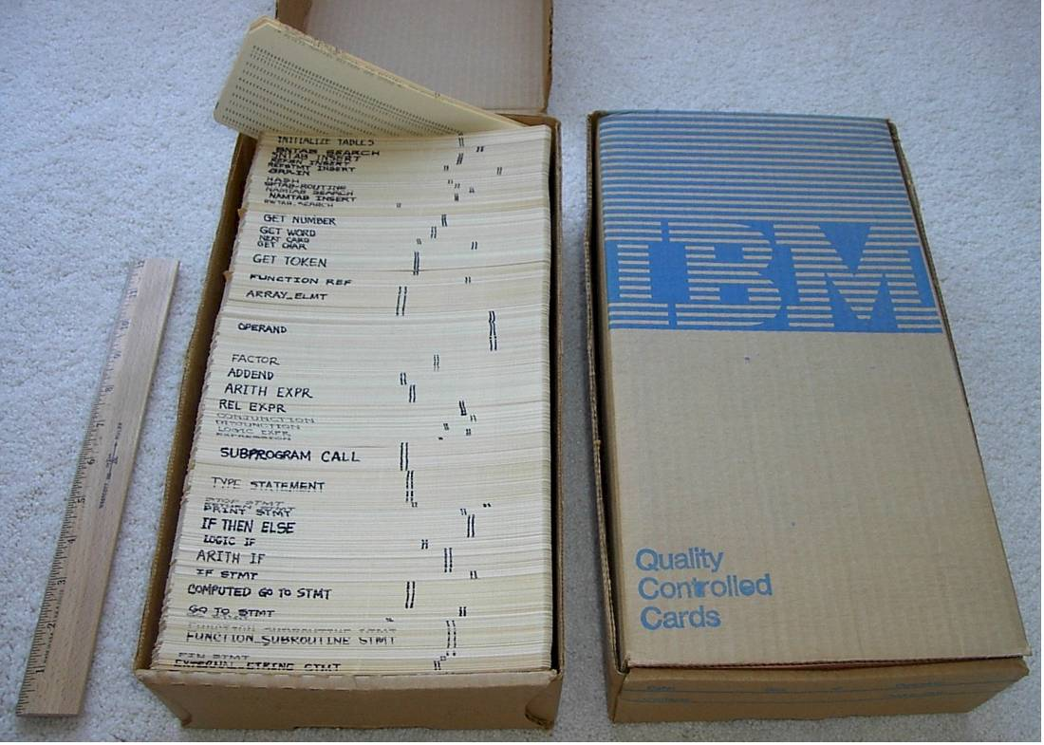
A Typical Job
A Fortran Compiler
3 ½ boxes of punched cards
Each box = 2000 cards (about ten pounds each)
A 35 pound program!

Slide 8
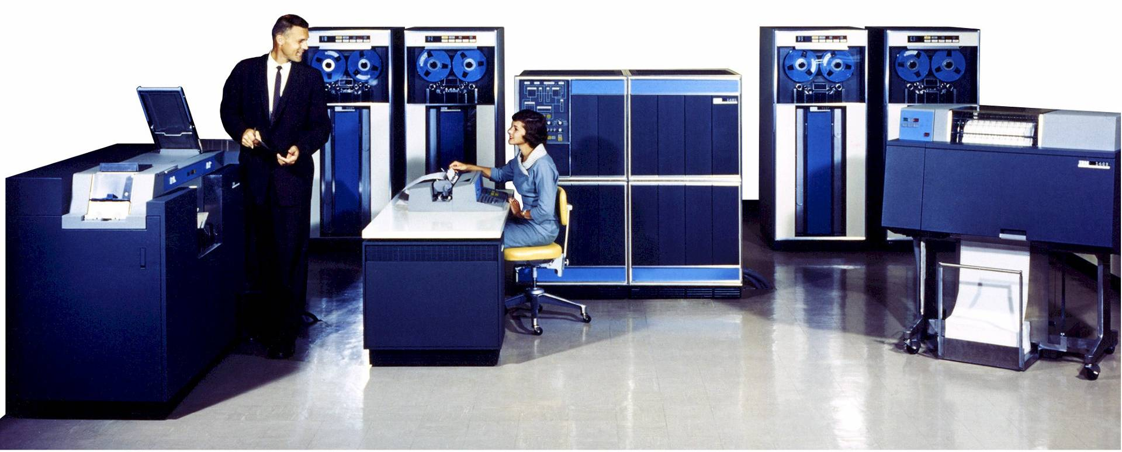
Late 1950s: Recognizable Operating Systems
IBM 1401 (1959)
1402 Card Read Punch
1407 Console
1401 CPU
729 Tape Drive
1403 Line Printer

Slide 9
The IBM 1401: the Model T of Computing
1959-1971
Inexpensive
Decimal (BCD) Arithmetic
High Sales Volume: over 12,000 sold
By the mid-1960s, almost half the computers in the world were 1401s
There is a fully restored and working IBM 1401 at the Computer History Museum in Mountain View

Slide 10
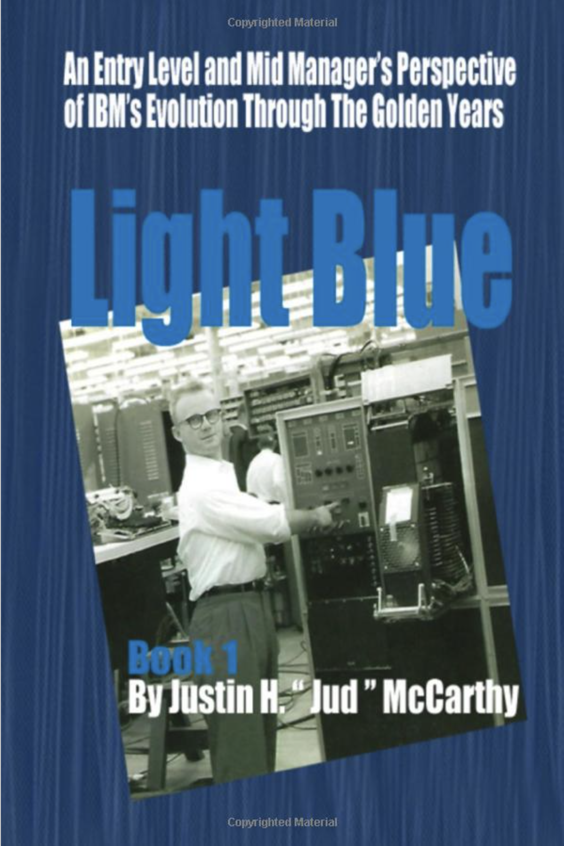
Interested in Early IBM History?
Light Blue: An Entry Level and Mid Management Perspective of IBM's Evolution Through the Golden Years
Justin “Jud” McCarty
June, 2020

Slide 11
Building Software
High Level Language Source Code (e.g. C++)
Assembly Language Source Code
Binary Machine Code
Compiler
Assembler
optional
Executable
Code
In-Memory
Code
Linker
Loader
Hardware Execution

Slide 12
Building Software: 1950s
High Level Language
Compiler
Assembly Language
Assembler
Binary Machine Code
optional
In-Memory
Code
Executable
Code
Hardware Execution
Linker
Loader

Slide 13
What Does a Modern Operating System Do?
Process Management
Interprocess Communications
Input / Output (I/O) Management
Memory Management
File System Management
System Functions and Kernel Mode
User Interaction – (maybe)

Slide 14
(1) Process Management
A modern computer runs many programs at the same time
Each instance of a running program is called a process
A program is just code
A process is code, data, and state information running on a computer
Each process has its own address space… in effect, it behaves as if it is the only program running
It’s important to understand that the operating system itself runs as one or more of these processes

Slide 15
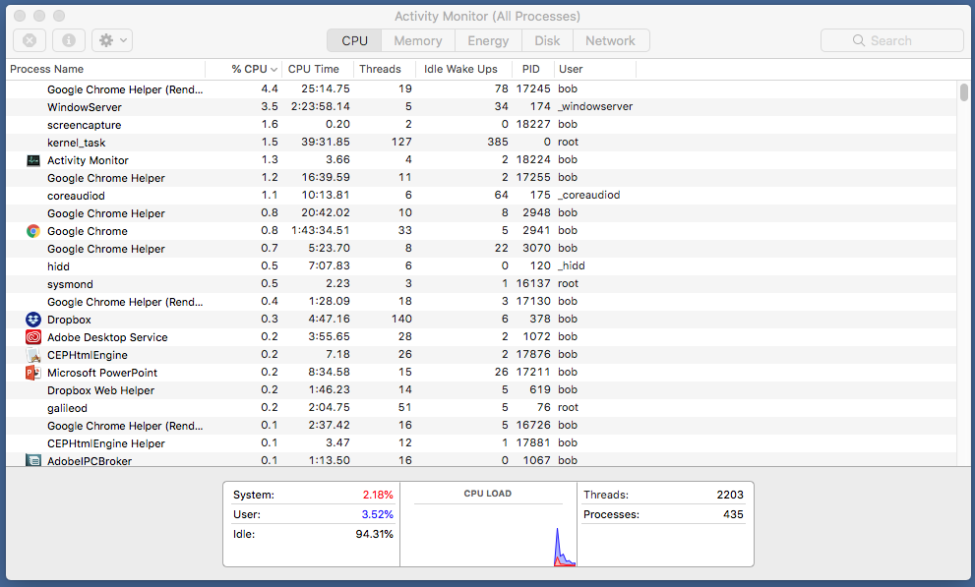
Processes – Mac OS: Activity Monitor
At the time of this snapshot, there were 435 processes running on my Macintosh

Slide 16
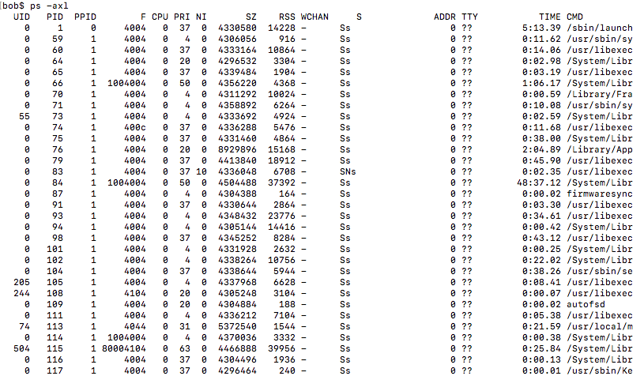
Processes – POSIX: ps –axl command

Slide 17
How Processes Are Created
A system function call is required to create a new process
A system function call is required to invoke the loader, load a program, and start execution
There may be two separate calls, or a single call to do both
In POSIX systems:
The fork() system call duplicates the currently running process – leaving TWO processes running the identical code, with identical states
The exec() system call loads an executable into the current process
For one program to “launch” another, it first calls fork(), and then the child process calls exec()

Slide 18
Fork() and Exec()
If ((pid = fork()) < 0) { // After this call there should be 2 processes running
printf(“Fork failed\n”);
exit(-1);
}
If (pid == 0) { // This is the child process
exec( “/users/robert/fibonnacci” ); // Invoke the loader
printf(“Exec failed\n”);
exit(-1);
}
// Parent process continues
printf(“Process ID of child is %d\n”, pid);

Slide 19
Fork() and Exec()
Process One
Process Two
Program A Code
Program B Code
Program A Code
pid = fork()
If (pid == 0)
exec(“Program B”);
pid = fork()
If (pid == 0)
exec(“Program B”);

Slide 20
How Processes are Terminated
The program may call a system function, such as the POSIX exit() function, that does some cleanup and deletes the process
When a program terminates without calling exit(), the system automatically executes some code that does the same thing
Alluded to in earlier lectures
With appropriate permissions, one process may force the deletion of another process by calling a system function such as the POSIX kill() function
The system may also have security features that will automatically kill processes that use too much CPU, memory, etc.

Slide 21
Interrupts
A multiprocessing operating system relies on interrupts
An interrupt is a signal sent to the processor that interrupts the current process
It may be generated by a hardware device or a software program
Types of interrupts
Timer
I/O state change (such as operation complete)
A signal from one process to another

Slide 22
What an Interrupt Does
Currently Executing Program
Interrupt Handler
Interrupt

Slide 23
Saving the Process State
In order to allow us to resume execution of the current process, the interrupt handler must save the state (such as the registers) of the currently executing program in a data structure called a Process Control Block (PCB)
The is a PCB for each process

Slide 24
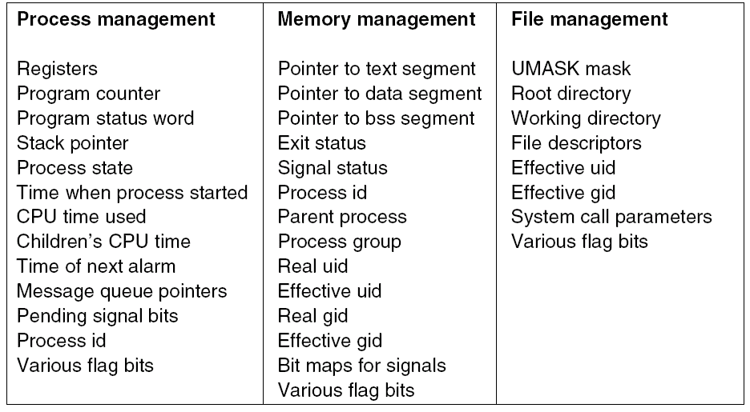
Contents of a Process Control Block (PCB)

Slide 25
Process Scheduling
The operating system makes sure that every program gets some time to run.
Scheduler: a component of the operating system that determines which process runs next
Dispatcher: The task of switching control to another process is called dispatching, and the code that accomplishes this is called the dispatcher
Time Slicing: The operating system uses a timer interrupt to periodically regain control so that it can switch from one process to another

Slide 26
Scheduling Algorithms
Round Robin: All processes get an equal time-slice, in order
Priority Scheduling: Some processes may be scheduled as higher priority, and get more or longer time slices
The original Lunar Lander had a single computer
The process that adjusted the attitude control jets ran at a higher priority than the process that updated the display
Adaptive Scheduling: adjust scheduling based on process performance
A system may give less time to “CPU hogs”
Many other algorithms are possible

Slide 27
Switching Processes
Currently Executing Process
Interrupt Handler
Next Process
Save state of current program in its PCB
Scheduler determines next process to execute
Dispatcher Restores state of next program from its PCB, and…
Transfers control to next program
Timer Interrupt

Slide 28
Process Switching and I/O
Typically, when a program starts an I/O operation, it can’t proceed until the operation is complete
In terms of processor speed, I/O operations take a really, really long time
The system scheduler will not give control to a process that is waiting for I/O.
We say that the process is blocked – or in an I/O wait state

Slide 29
What Happens When a Program Initiates I/O
The program calls an operating system routine to start the I/O operation
The operating system routine will:
Save the process state in its PCB
Set a flag in the process’s PCB to indicate that the program is in an I/O wait state
Initiate the I/O operation
Call the scheduler to determine which process to execute next
Call the dispatcher to give control to that process

Slide 30
When an I/O Operation Completes
A completed I/O operation generates an I/O Interrupt
The interrupt handler gains control, and:
Saves the state of the currently executing process, whatever it may be
Determines which process initiated the I/O operation that just completed
Sets the status in that process’s PCB to indicate it is ready
Calls the scheduler to determine which process to execute next
Calls the dispatcher to give control to that process
Note that the “next process” may or may not be the process that initiated the I/O operation
I/O completion simply makes that process ready, or eligible for scheduling

Slide 31
Returning Control to the I/O Caller
Eventually, the dispatcher will return control to the process that initiated the I/O operation
At that time, the system I/O function will return, passing back the results of the I/O operation

Slide 32
I/O Processing
System I/O Function
Executing Program
Save the process state in its PCB
Set I/O wait state
Initiate the I/O operation
I/O Completion Interrupt
Set status in original caller’s PCD to ready
System I/O Call
Some Time Later
Process gets scheduled
Dispatcher returns control, along with I/O results

Slide 33
Process Synchronization and Communication
A process can pause, waiting for the completion of another process using the wait() function call
A POSIX shell may launch a child process to run a program from the command line, and wait for its completion
Inter-Process Communication (IPC): A process may make a system call to send a signal to another process, or to set up a signal handler to receive signals
Just as with I/O wait states, these waits are indicated by a special blocked status in the PCB, preventing the process from being scheduled until the condition is met

Slide 34
I/O Processing
System Wait Function
Save the process state in its PCB
Set blocked state
Process 2
Process 1
System Signal Function
Clear blocked state in Process 1 PCS
wait()
signal(1)
Some Time Later
Process gets scheduled
Dispatcher returns control

Slide 35
(2) Input / Output (I/O) Management
On early computers, I/O was performed by the processor:
Of course, today we don’t tie up the processor waiting for each byte!
WAITING | TD | DEVICE | ; wait until device is ready
 | JEQ | WAITING
 | RD | DEVICE | ; get a byte from device
 | STA | BUFFER, X | ; store byte in buffer

Slide 36
Adding a Primitive I/O Subsystem
System functions to READ and WRITE data
READ( device, buffer, count );
WRITE( device, buffer, count );
The calling process is placed in an I/O wait state
Functions place the parameters in an I/O Control Block (IOCB)
An I/O Process
The I/O process contains a loop: for each IOCB:
Check to see if the device is ready
If so, READ or WRITE the next byte
If the I/O operation is complete, set the status to ready in the calling process’s PCB

Slide 37
A Modern I/O Subsystem
On modern systems, I/O is handled by hardware, rather than relying on the processor for byte-by-byte transfers
System functions to READ and WRITE data
READ( device, buffer, count );
WRITE( device, buffer, count );
The calling process is placed in an I/O wait state
Functions place the parameters in an I/O Control Block (IOCB)
Functions initiate the I/O transfer using dedicated I/O controllers

Slide 38
A Modern I/O Subsystem - Continued
We do not need an I/O process
The I/O controllers will generate an interrupt when the transfer is complete
The interrupt handler will set the status to ready in the calling process’s PCB

Slide 39
(3) Memory Management
Physical Addressing
Early computers did not have any form of address translation
Addresses used in the program exactly correspond to physical memory addresses
The size of physical memory was limited to the address range of the instruction set
To load multiple programs or code blocks into memory, the system required a relocating loader
Microcomputers in the 1970s and embedded computers today use physical addressing

Slide 40
Partitioned Memory
Partitioned Addressing
Partitioned Addressing requires hardware support – a Memory Management Unit (MMU)
A “base address” register that can be set when a process is dispatched, and possibly start and end addresses to provide memory protection
Memory references are translated in hardware by adding the “base address register” to determine the address in physical memory
The amount of memory available to any process may be limited by the instruction set, but physical memory may be much larger

Slide 41
Partitions
Process 1 Address Space
Process 1 Address Space
Physical Memory
Process 2 Address Space
Program 1 Executable Code
Program 1 Executable Code
Program 2 Executable Code
Program 2 Executable Code

Slide 42
Memory Fragmentation
Process 1 Address Space
Starting State
Process 2 Ends
Process 4 Doesn’t Fit!
Process 1 Address Space
Process 1 Address Space
Process 4 Address Space
Process 2 Address Space
We have enough memory… but it’s not contiguous
Process 3 Address Space
Process 3 Address Space

Slide 43
Memory Fragmentation – Dynamic Relocation
Process 1 Address Space
Starting State
Process 2 Ends
Process 4 Starts
Process 1 Address Space
Process 1 Address Space
Process 1 Address Space
Process 2 Address Space
Process 3 Address Space
Process 3 Address Space
Process 3 Address Space
Process 4 Address Space

Slide 44
Memory Protection
Memory Protection prevents one process from reading or writing memory used by another process
In addition to a base address, the MMU may support a start address and end address.
For each memory reference, the MMU adds the base address, and determines if the resulting physical address live within the bounds of the start and end
If not, an error interrupt is generated

Slide 45
Getting Fancy – Modern MMUs
Separate base addresses for code, data, and shared memory
Process 1 Address Space
Process 1 Address Space
Physical Memory
Process 2 Address Space
Program 1 Executable Code
Program 1 Executable Code
Program 2 Executable Code
Shared Dynamic Library
(code)
Shared Dynamic Library
(code)
Program 2 Executable Code
(Process 2 Data)
(Process 1 Data)
Shared Dynamic Library
(code)
(Process 1 Data)
(Process 2 Data)

Slide 46
Virtual Memory
Virtual Memory: a system of software and hardware that allows portions of a program’s memory to be temporarily cached on disk, to minimize the requirements for physical memory.
Allows the operating system to load and execute programs with memory requirements that total far more than the available physical memory.
Virtually memory systems divide the memory address space into pages, each of which is separately mapped by the MMU.
Not all pages reside in physical memory. Pages that are not loaded in physical memory are cached on disk.

Slide 47
Virtual Memory Mapping
Process 1 Address Space
Process 1 Address Space
Physical Memory
Disc Storage
Page 1
Page 1
Page 2
(some other process)
Page 3
Page 2
Page 4
Page 5
Page 5
Page 4
Page 6
(some other process)

Slide 48
Virtual Memory Mapping
Requires a separate base address for each page in the process’s address space.
The MMU maps each memory reference to the corresponding location in physical memory by adding the base address.
If the page does not reside in physical memory, the MMU will generate a page fault interrupt.
The process will be placed in an I/O wait state
The requested memory page will be loaded from disk into physical memory
This may require a page that is currently in physical memory to be moved to disk (swapped out) in order to free up space

Slide 49
Choosing the Page to Swap Out
If a page is already on disk, and the copy in memory has not been modified, it doesn’t actually need to be written to disk – so it’s a good candidate to free up
Other algorithms include:
FIFO – First In, First Out
LRU – Least Recently Used
LFU – Least Frequently Used

Slide 50
Why the Algorithm is Important
Going to disk to “swap in” a page (and possibly “swap out” a page to free up memory) dramatically slows program execution
If a RAM access took one SECOND, a disk access would take one DAY
A system that has insufficient physical memory needs to swap frequently, resulting in thrashing, a condition in which the system is essentially unable to perform useful work because of constant page swaps.

